Slide 1
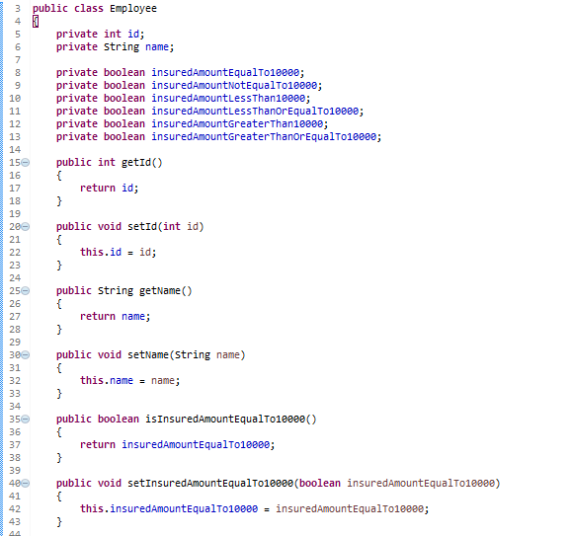
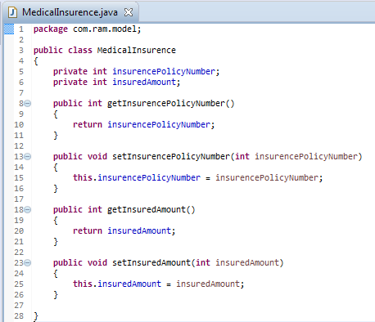
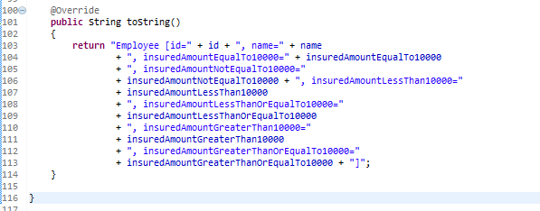
Spring EL Relational Operators
…..
…..

Slide 2
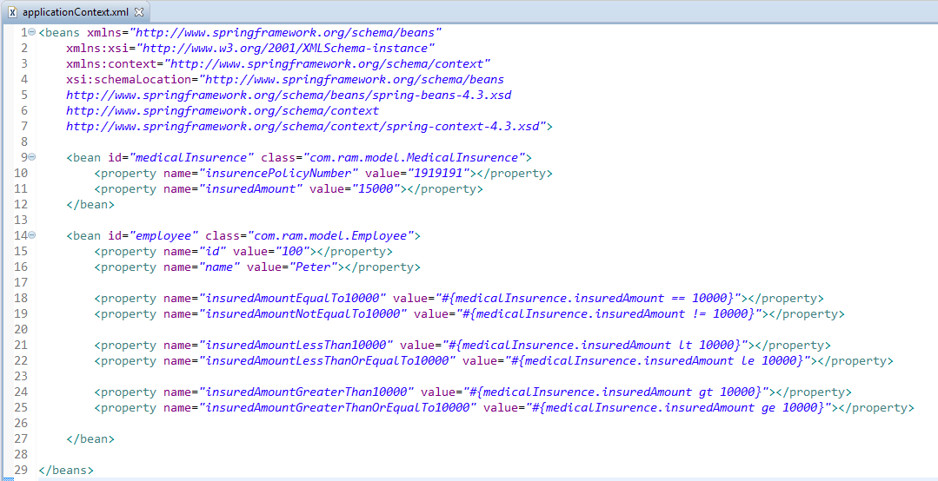
Spring EL Relational Operators
Spring EL supports Relational operators – equal (==, eq), not equal (!=, ne), less than (<, lt), less than or equal (<= , le), greater than (>, gt), and greater than or equal (>=, ge).

Slide 3
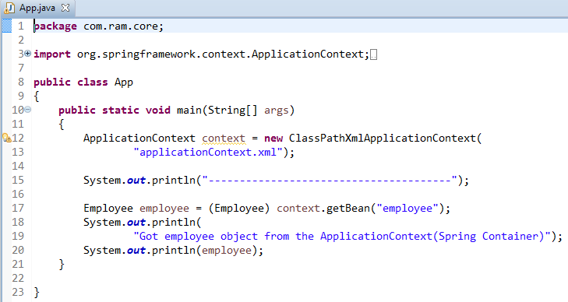
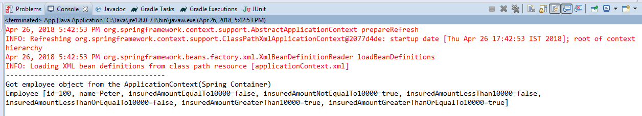
Spring EL Relational Operators

